Slide 1
Project Title: Provision of Work bench at Ahia Flowstation
Charter Template
Business Case/objectives:
Ahia flow station is a distant station & presently the hub of Rumuahia hydrocarbon liquid production. It takes almost 1:30 hrs. to access Ahia FS from EPC. Hence, whenever there is a minor repairs, the maintenance crew will travel to the station, removed the components and returned to EPC or sent to w/shop to enable the team effect repairs. Thereafter, revisit the station with repaired component/equipment for installation & commissioning. This entire process delays the repair and prolong the equipment down time & consequently production deferment. Security exposure for personnel going to & fro and associated logistics & security cost just to fix a particular equipment failure. This project aims to provide a work bench in an existing utility building where community generators were formerly kept. In fact the utility building provides a fit & designated location for incorporating mini maintenance workshop at the Ahia FS. The workshop will provide platform for quick on site repairs intervention which will drastically reduce equipment downtime; a failure could be fixed with just a visit and restoring production. Installation and having an operational work bench on site will revolutionize equipment up time in such a remote location.
Potential Benefits & Measurement:
The execution of this project will bring about the following benefits:
1. Improved Equipment & Overall plant uptime
2. Reduce Personnel Security exposure
3. Reduce kilometre Driven & diesel cost
4. Reduce logistics & security cost
5. Reduced production deferment
Project Scope/Actions :
Identify & populate workshop requirement
Liaise with Asset engineering/w/shop to cost items requirement
Secure MOC
Secure budget approval for provision of w/shop items
Installation of mini-workshop tools & equipment
Commissioning
AAR
Critical Success Factors:
Leadership support
Effective collaboration
Budget provision
High-level Timeline:
L0-L1: Identify Tools Equipment & provide Cost requirement Sept,2018
L2: Secure approved MOC –Sept. 2018
L3: Provide budget & make request -Oct. 2018
L4: Installation of workshop tools & equipt.- Feb.2019
L5: Commissioning-March, 2019.
Initiative End
Project Sponsor: Wilcox E/Aniemeke S
Implementation Lead: Opara D/Digbani
Project Team:
Amadi James
Ajagbe Oluwasegun
Dahunsi O
Adedoyin

Slide 2
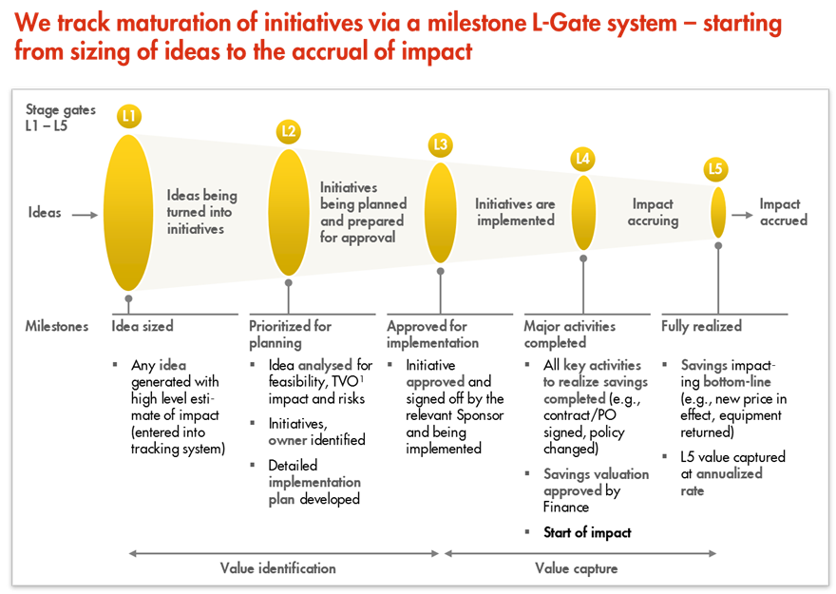
L1 – L5 Gates

